Slide 1
Course Introduction

Slide 2
Phase 1
Phase 2
Phase 3
Self-Study
Core Concepts
Mini Projects
Internship
Full Projects
Placement Assistance

Slide 3

•D-Tribe Registration link:-https://tribe.datamites.com/feed.
•Events of D-Tribe are:-
1.ASK DATAMITES
2.PYTHON FOR AI AND DATA SCIENCE
3.CAREER GUIDANCE AND JOB FAIR
4.WEBINAR ON TOPICS RELATED TO DATA SCIENCE
5.ARTICLES, QUIZ, BLOGS WILL BE POSTED

Slide 4

For Module-Level Assessments:
Link to register https://datamites.com/exam/Registers

Slide 5

•After 2 projects completion you are eligible for PAT service.
•Resume service.
•Complete all module level assessments.
•Complete job ready assessment.
•Mock Interview.
•Based on all above scores, if score is above 6,eligible for interview with clients.

Slide 6

4-hr study day
Keep running notes
Multiple Learning Sources
Stick to Syllabus

Slide 7


Data Science Foundation
Accredited by IABAC™

Slide 8
Who can pursue this course?
Working Professionals, who want to switch to Data Science
Data Professionals, Business Analyst, Software Engineers
Senior Professionals, Managers
Students, Beginners from any background
Anyone, who wants to learn Data Science

Slide 9
What is Hadoop
Hadoop is an open-source framework used for storing and processing large datasets in a distributed computing environment. It is designed to handle big data efficiently by splitting it across multiple machines in a cluster.
Key Components of Hadoop :
HDFS (Hadoop Distributed File System) – A distributed file system that stores large data across multiple nodes. It breaks files into smaller blocks and distributes them.
MapReduce – A programming model used for parallel data processing. It consists of:
Map Phase – Splits data and processes it.
Reduce Phase – Aggregates and compiles the results.

Slide 10
Data Science Introduction

Slide 11
What is Data Science?
Demistifying Data Science
Data science is an interdisciplinary field that uses scientific methods, processes, algorithms and systems to extract knowledge and insights from many structured and unstructured data. (Ref: Wikipedia)
Data science is the field of study that combines domain expertise, programming skills, and knowledge of mathematics and statistics to extract actionable insights.
Data Science can be simply stated as “Insights from Data”

Slide 12
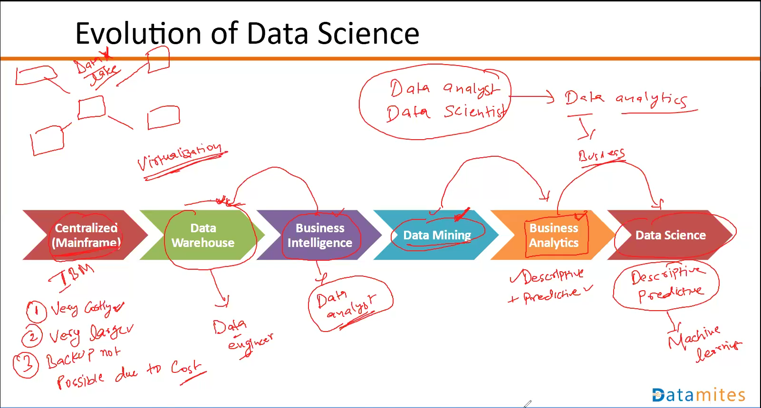
International Business Machines

Slide 13
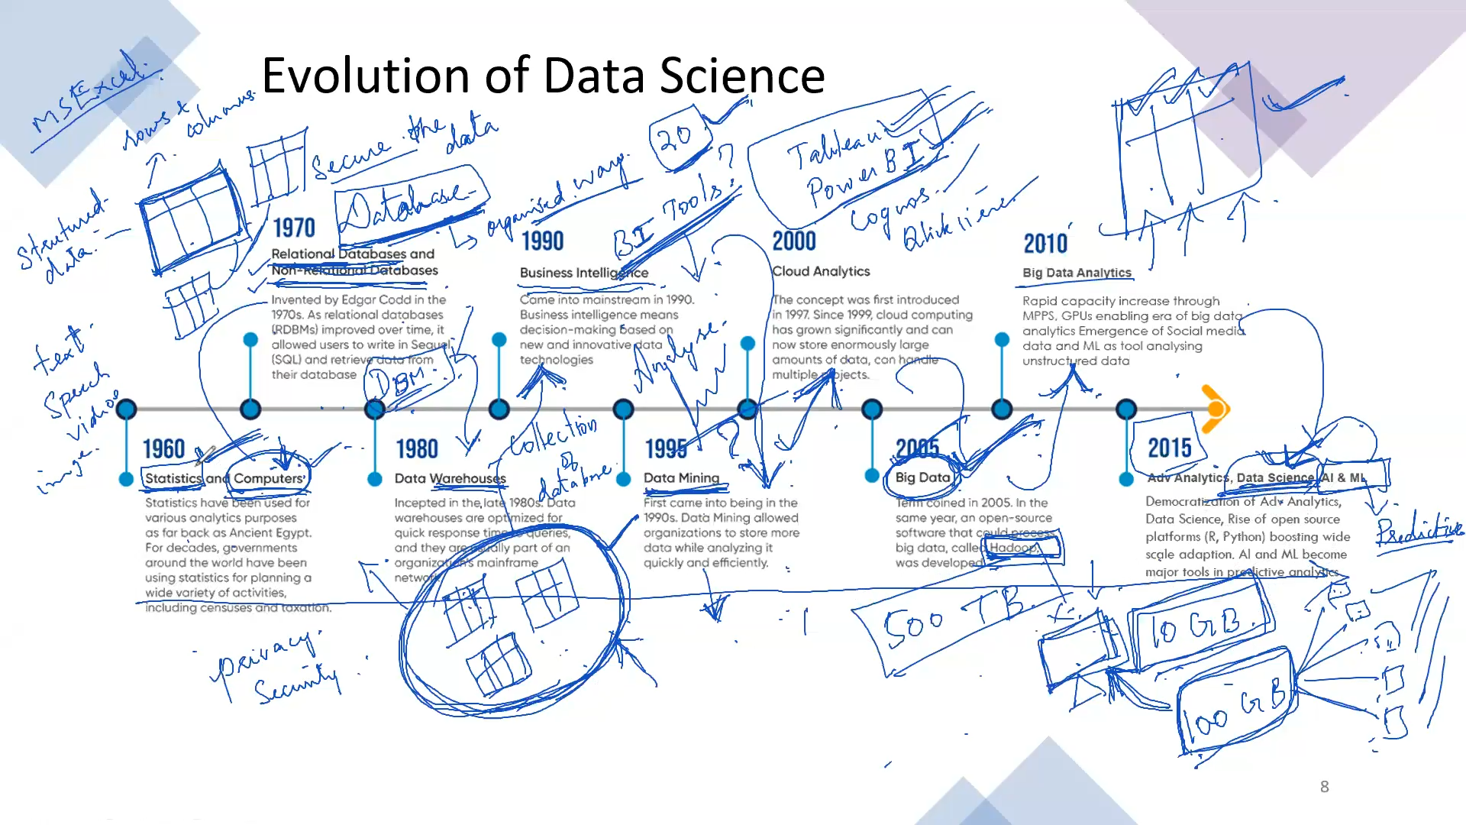

Slide 14
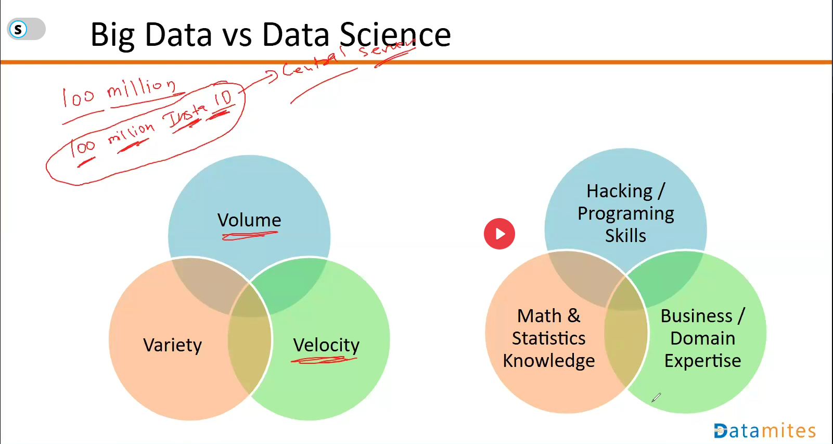

Slide 15
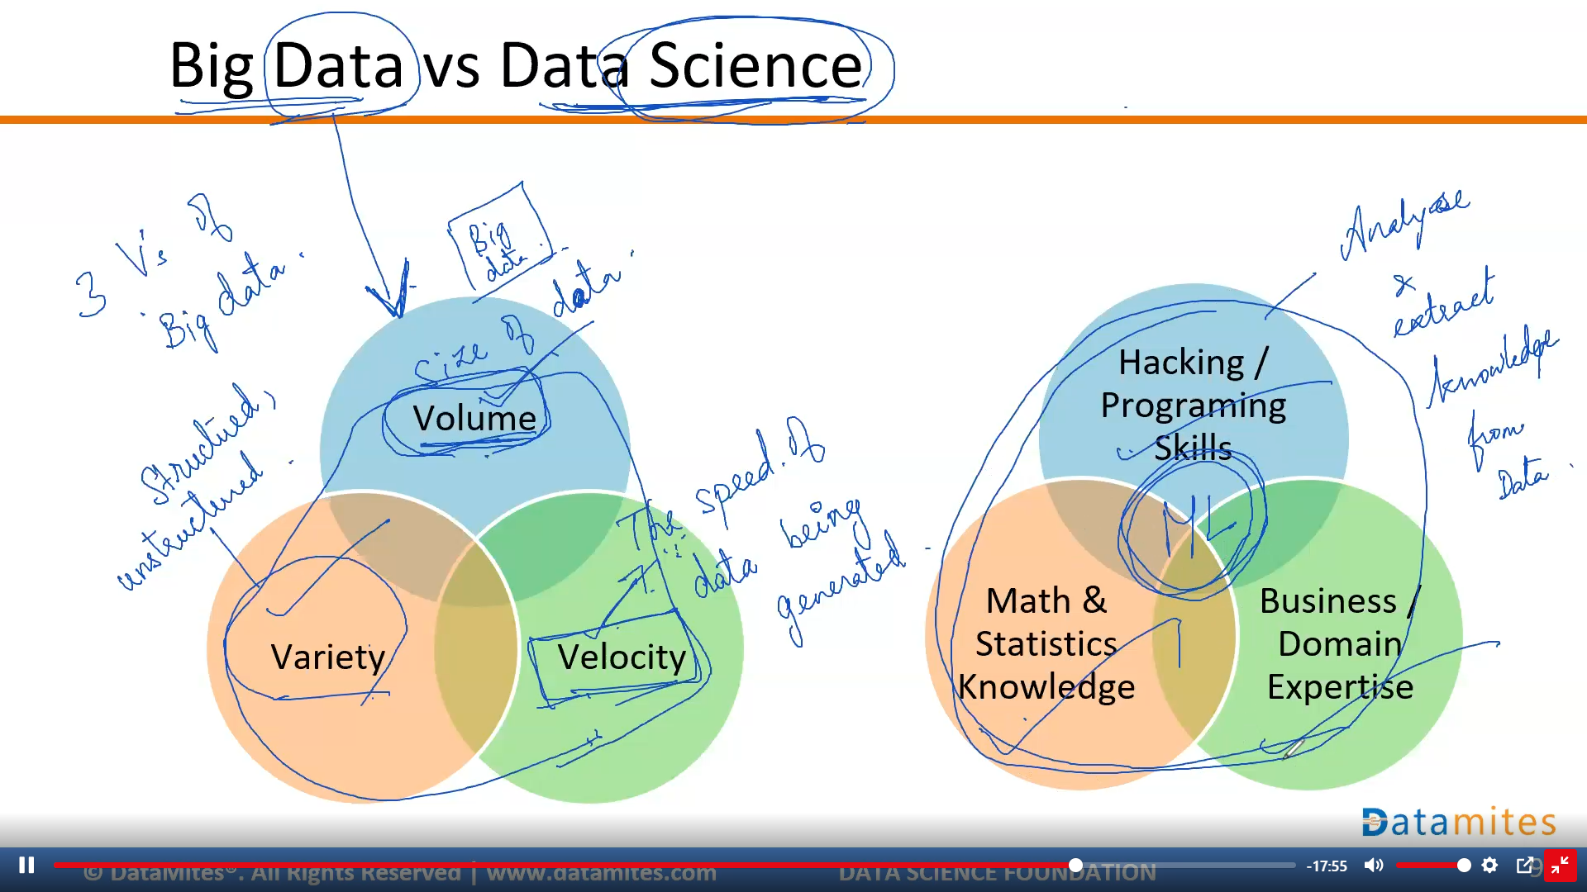

Slide 16
Big Data vs Data Science
Definition | Deals with storing, processing, and managing massive amounts of data. | Extracts insights from data using statistical, analytical, and AI techniques.
Technologies Used | Hadoop, Spark, Hive, NoSQL, HDFS. | Python, R, SQL, Machine Learning, AI.
Focus | Handling large-scale structured & unstructured data. | Using data to make predictions, decisions, and insights.
Processes | Data collection, storage, and distributed computing. | Data cleaning, visualization, modeling, and predictive analysis.
Outcome | Efficient data management and accessibility. | Solving business problems using data-driven insights.
Example Use Case | Managing petabytes of customer transaction data for a retail company. | Predicting customer behavior to increase sales using ML models.

Slide 17
Data Science vs Business Analytics
Data Science | Business Analytics
Involves programming / coding | Minimal/No coding required.
Data Science uses both structured and unstructured data | Business Analytics uses mostly structured data
Data Science extensively involves Machine Learning and Artificial Intelligence as tools. | Business Analytics use traditional statistical and forecasting techniques.

Slide 18
Data Science vs Business Analytics
Definition | Uses statistical, ML, and AI techniques to extract insights from data. | Uses data analysis to improve business decision-making.
Focus | Predictive & prescriptive modeling, automation, AI. | Business strategy, trend analysis, dashboards.
Techniques Used | Machine Learning, Deep Learning, Data Engineering. | Descriptive & diagnostic analytics, visualization.
Tools Used | Python, R, SQL, TensorFlow, Hadoop, Spark. | Excel, SQL, Power BI, Tableau, SAS.
Outcome | Building AI models, making automated data-driven predictions. | Helping businesses make better decisions using past data.
Example Use Case | Predicting customer churn using ML models. | Analyzing past sales data to improve future sales strategy.

Slide 19
Analytics Classification
Evolved Organization
With Decision driven by Prescriptive Analytics
Predictive Analytics
Prescriptive
Analytics
Diagnostic Analytics
Descriptive Analytics

Slide 20
Types of Analytics Classification
Descriptive Analytics (What happened?)
Summarizes historical data to understand trends and patterns.
Example: Sales reports showing revenue trends over the last 5 years.
Tools: Excel, SQL, Tableau, Power BI.
Diagnostic Analytics (Why did it happen?)
Analyzes past data to determine reasons for trends or anomalies.
Example: Identifying why website traffic dropped suddenly.
Tools: SQL, Python, Google Analytics.
Predictive Analytics (What might happen?)
Uses machine learning and statistical models to forecast future outcomes.
Example: Predicting customer churn based on past purchase behavior.
Tools: Python, R, Machine Learning models.
Prescriptive Analytics (What should be done?)
Provides recommendations and actions to optimize outcomes.
Example: Suggesting the best pricing strategy to maximize revenue.
Tools: AI, Optimization Algorithms, Decision Trees.

Slide 21
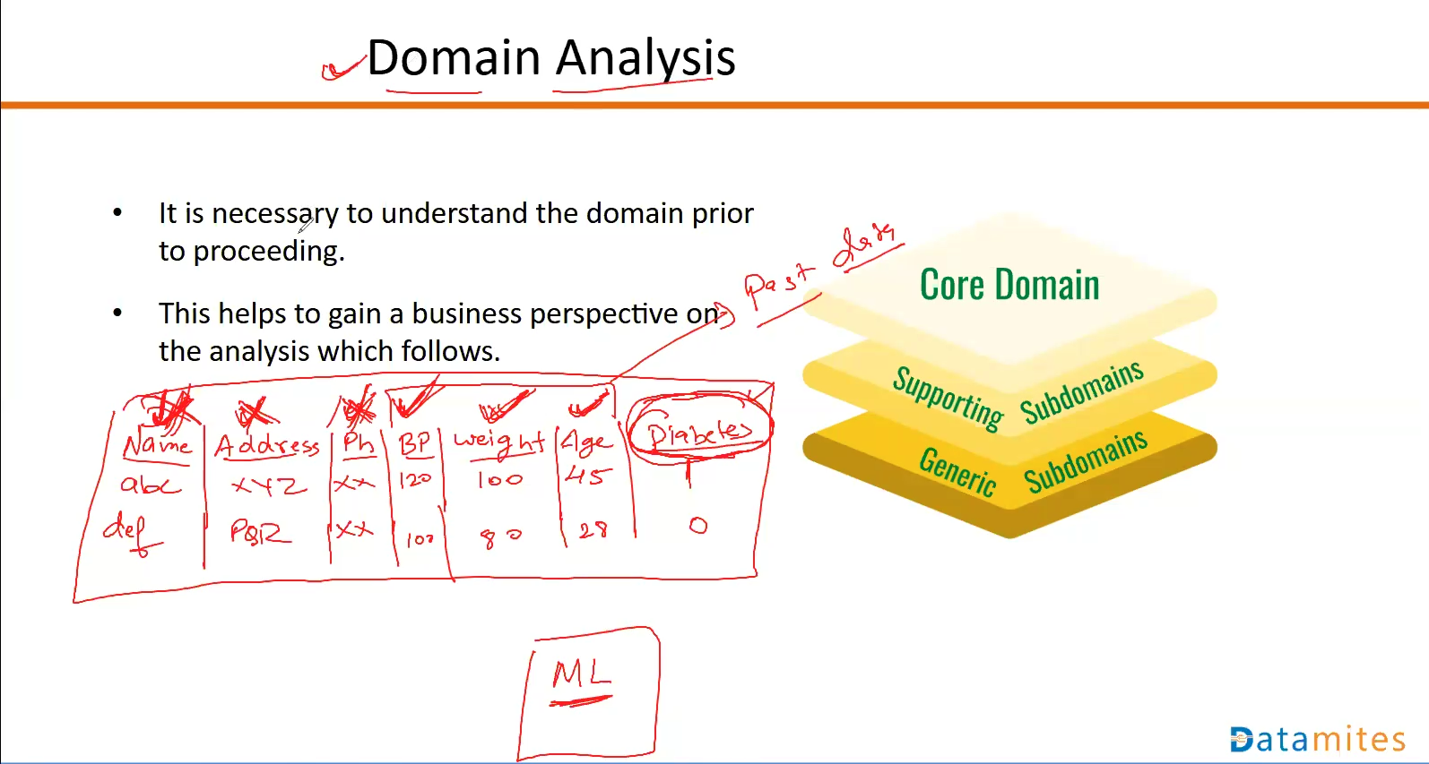

Slide 22
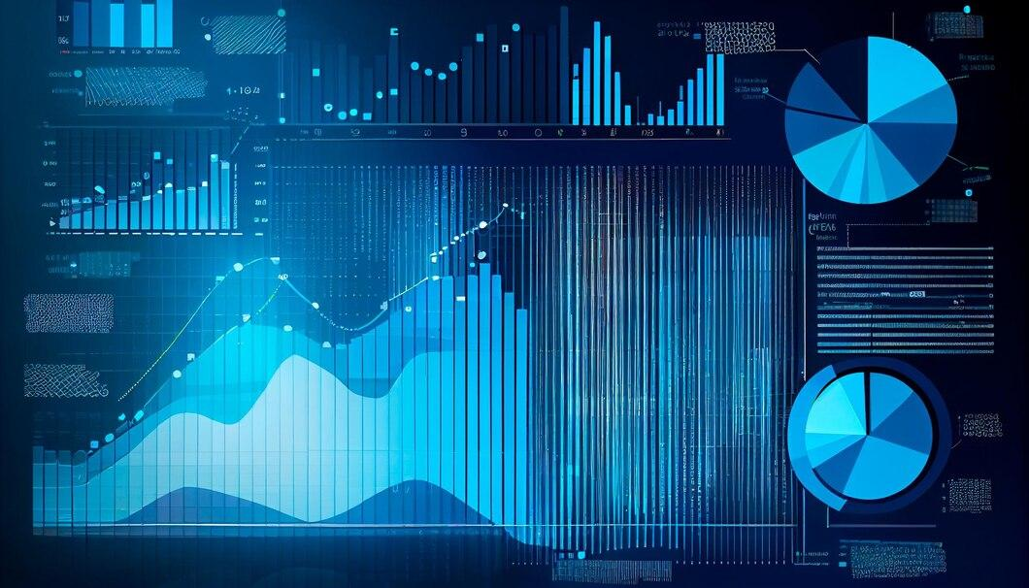
Exploratory Data Analysis
EDA is the process of analyzing and summarizing data to understand its structure, detect patterns, and identify relationships before applying machine learning models.
EDA allows us to arrive at patterns and relationships within the data.
This includes the use of visual tools, graphical analysis.

Slide 23
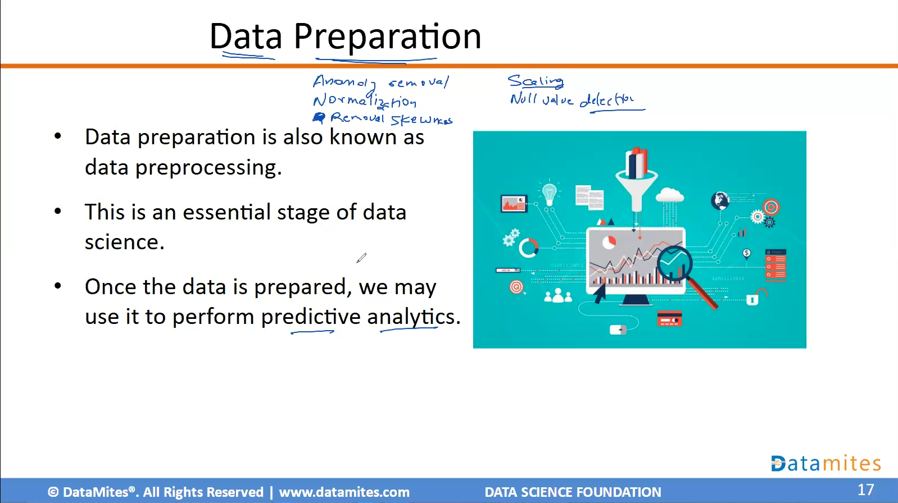

Slide 24

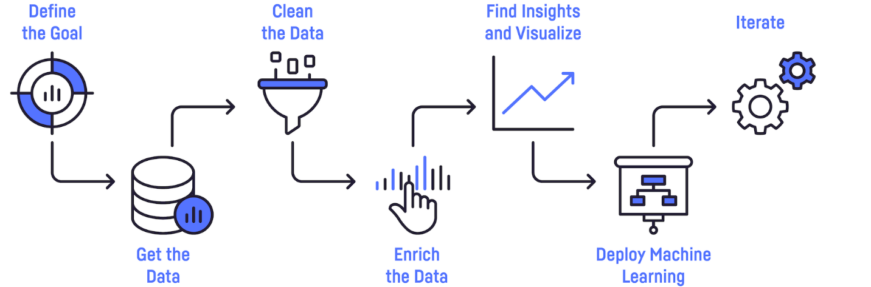



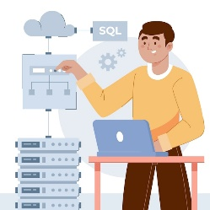
MLOps Engineer
Business Leader /
Domain Experts
Data Engineer
Data Scientist / Data Analyst
ML Engineer

Slide 25
Machine Learning Introduction

Slide 26
What is Machine Learning?
Machine learning is a field of computer science that gives computers the ability to learn without being explicitly programmed.
Machine Learning (ML) is a branch of artificial intelligence (AI) that enables computers to learn from data and make predictions or decisions without being explicitly programmed.
The term "explicitly" refers to a way of expressing or stating something clearly and directly, without any ambiguity or implication. It is often used to convey a strong sense of intention or emphasis, implying that the speaker or writer is deliberately and openly expressing their thoughts or opinions.

Slide 27
How Does Machine Learning Work?
Collect Data – Gather raw data from various sources.
Preprocess Data – Clean, transform, and prepare data.
Choose a Model – Select an appropriate ML algorithm.
Train the Model – Use training data to learn patterns.
Test the Model – Evaluate performance on unseen data.
Deploy & Improve – Optimize and deploy the model in real-world applications.

Slide 28
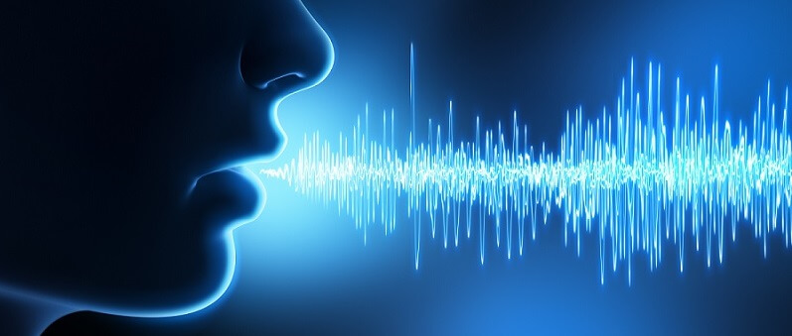

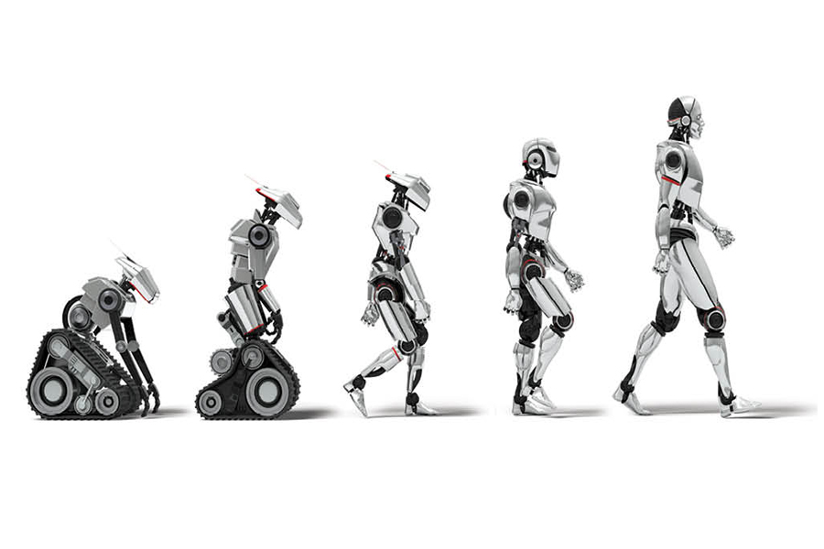
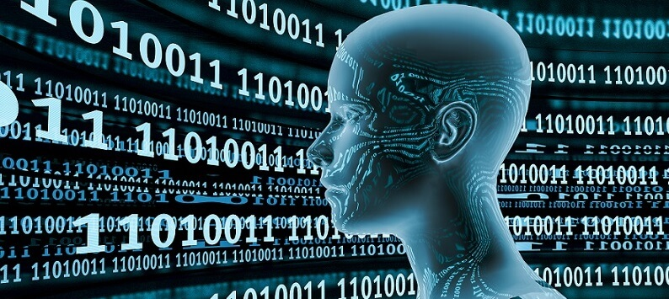
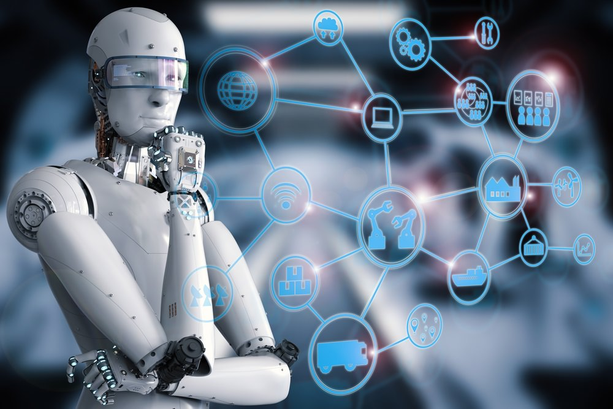
Areas of Artificial Intelligence
Computer Vision
Natural Language Processing
Robotics
Machine Learning & Deep Learning
Decision Making

Slide 29
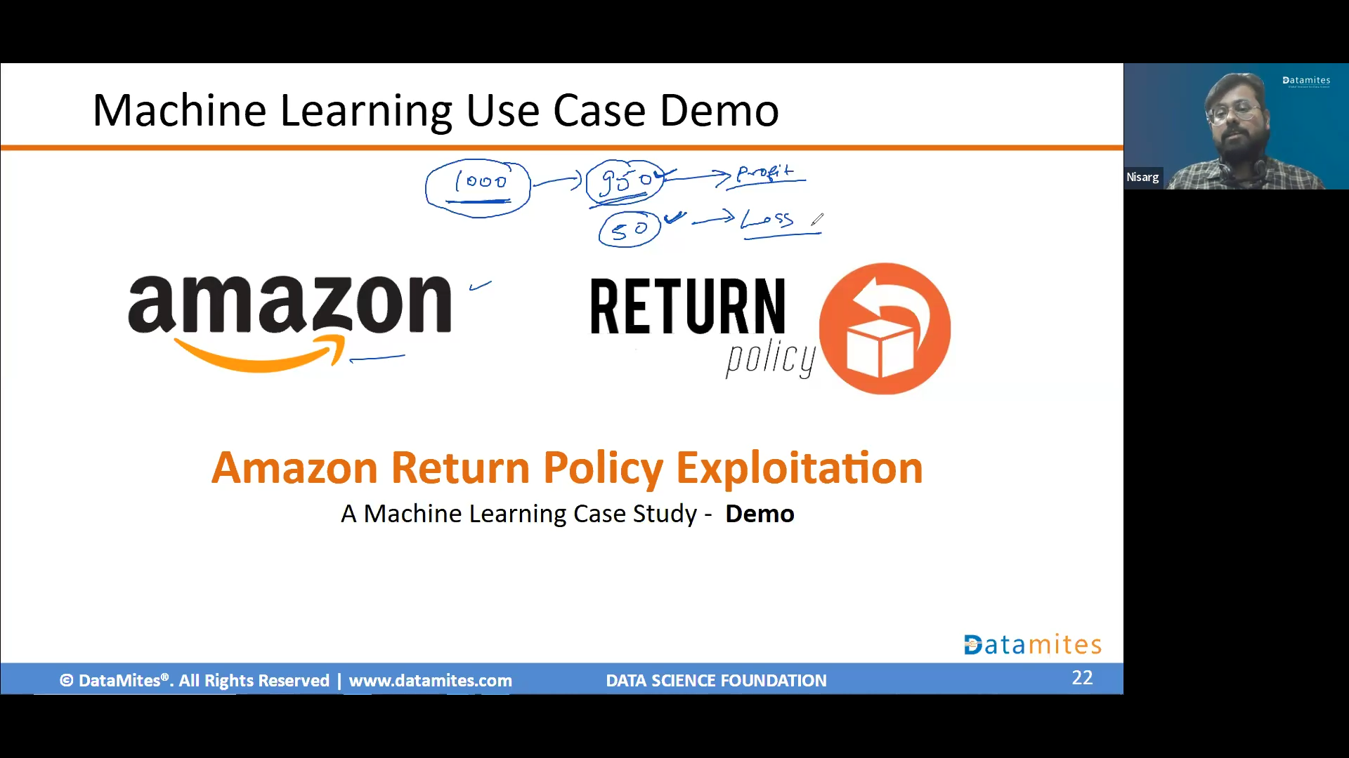

Slide 30
Types of Machine Learning
Supervised machine learning
Unsupervised machine learning
Semi-supervised machine learning
Reinforcement machine learning

Slide 31
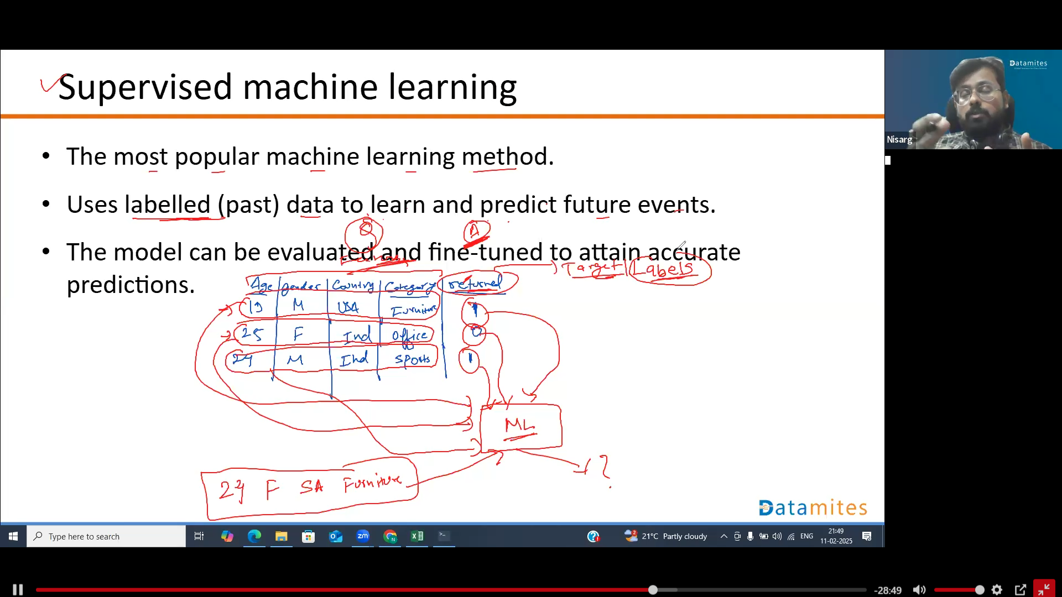

Slide 32
Supervised Learning (Labeled Data) 📊
The model learns from input-output pairs (X → Y).
Regression: Predicts continuous values (e.g., house prices, stock prices).
Classification: Predicts categories (e.g., spam detection, fraud detection).
📌 Examples: ✔ Linear Regression → Predicting house prices ✔ Logistic Regression → Email spam classification

Slide 33
Unsupervised machine learning
Used when the past data used to train is neither classified nor labeled.
The system doesn’t figure out the right output, but it explores the data and can draw inferences from datasets to describe hidden structures from unlabeled data.

Slide 34
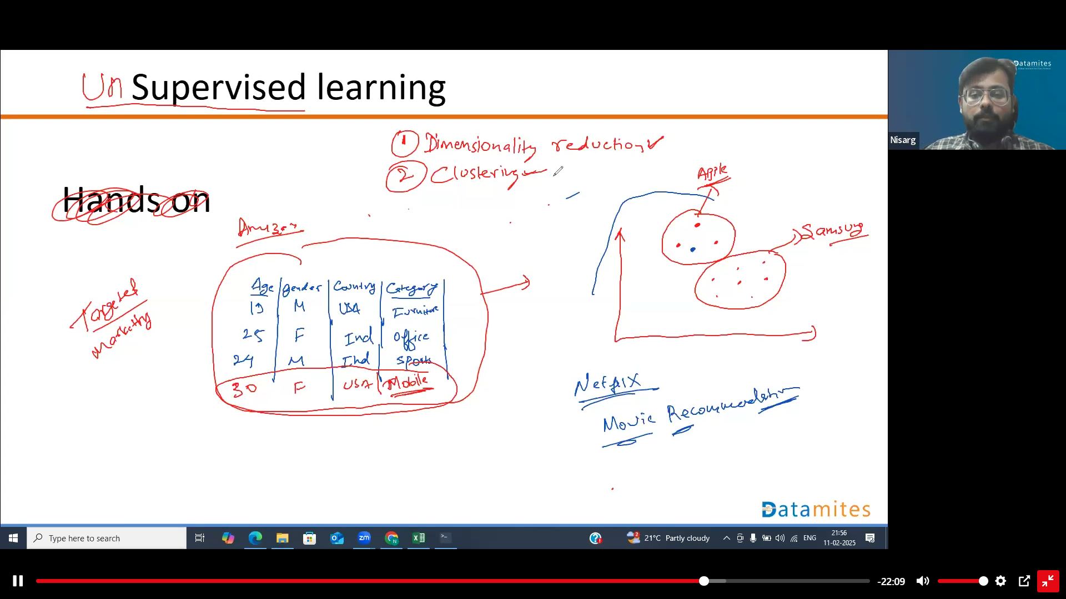

Slide 35
Unsupervised Learning (No Labels) 🧩
The model finds hidden patterns in unlabeled data.
Clustering: Groups similar data points together (e.g., customer segmentation).
Dimensionality Reduction: Reduces features while preserving important info (e.g., PCA).
📌 Examples: ✔ K-Means Clustering → Customer segmentation ✔ Principal Component Analysis (PCA) → Feature reduction

Slide 36
Semi-supervised machine Learning
Fall somewhere in between supervised and unsupervised learning, since they use both labeled and unlabeled data for training – typically a small amount of labeled data and a large amount of unlabeled data.
Systems using this method can considerably improve learning accuracy.

Slide 37
Reinforcement machine learning
Learning by interacting with its environment by producing actions and discovers errors or rewards.
This method allows machines and software agents to automatically determine the ideal behavior within a specific context in order to maximize its performance.
Simple reward feedback is required for the agent to learn which action is best; this is known as the reinforcement signal.

Slide 38
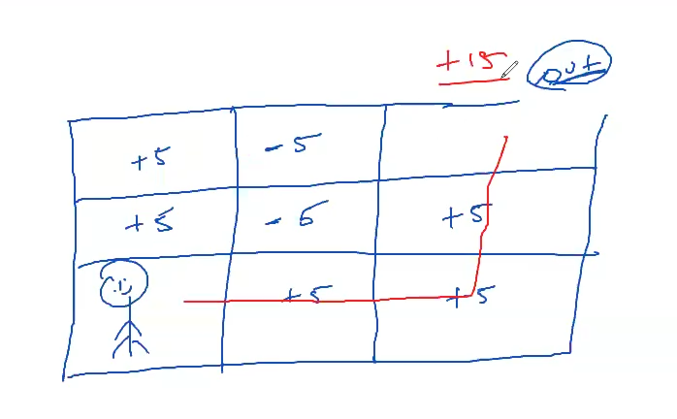
Reinforement Learning

Slide 39
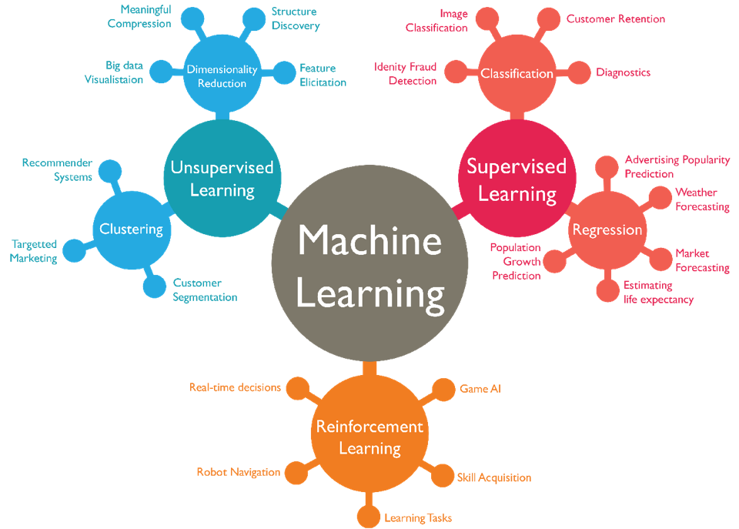

Slide 40
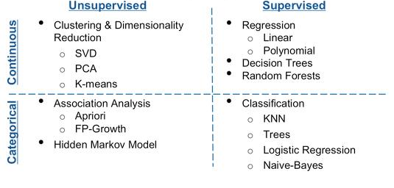
Machine Learning
Machine Learning Algorithms

Slide 41
Data Science and Related Fields

Slide 42
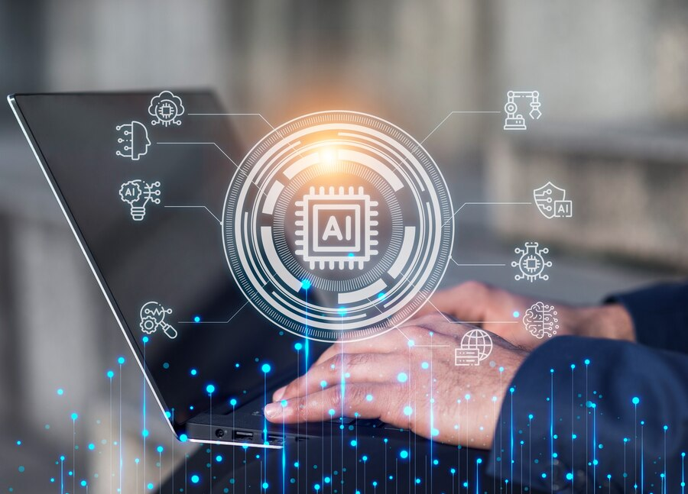
Introduction to AI
Artificial Intelligence is the simulation of human intelligence in machines that are programmed to think and learn like humans.

Slide 43

Computer Vision
Enabling Machines to See and Interpret Visual Information.
Includes image processing, feature extraction, and object recognition
Applications:
Facial recognition, Gesture Recognition, Crop monitoring, Diagnostic Imaging

Slide 44
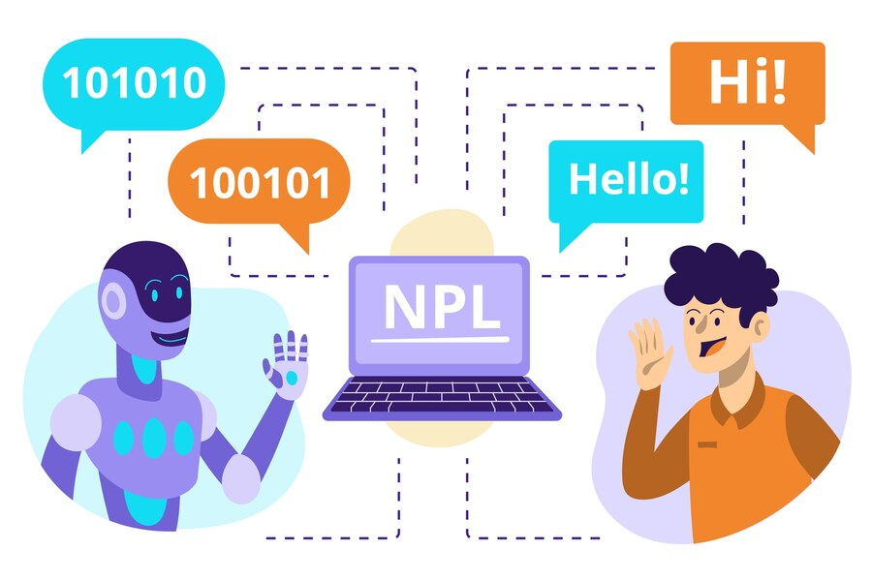
Natural Language Processing
Bridging the Gap between Computers and Human Language
NLP is a branch of artificial intelligence that focuses on the interaction between computers and human language.
Includes text processing, sentiment analysis, language generation
Applications: Chatbots, Language translation, and Voice recognition

Slide 45
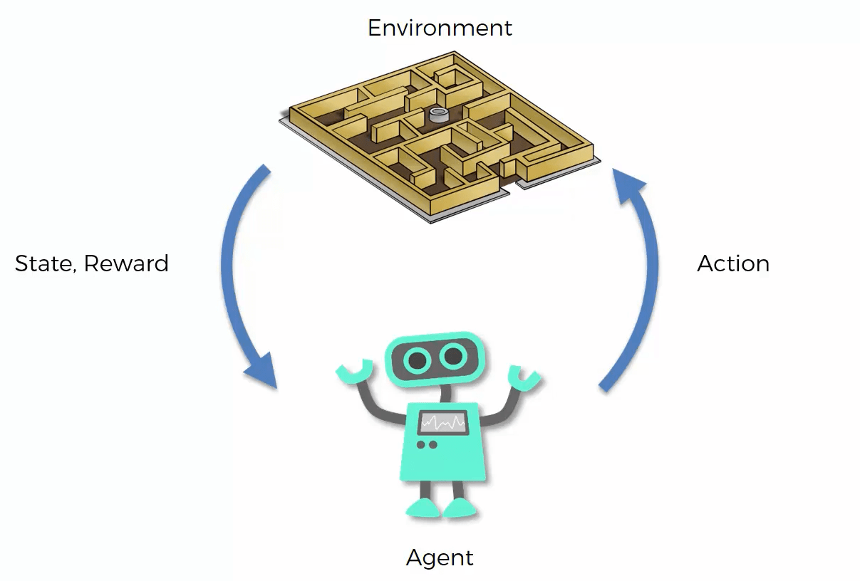
Reinforcement Learning
Reinforcement Learning is a type of machine learning where an agent learns to make decisions by taking actions in an environment to maximize cumulative rewards.
Applications: Gaming, robotics, and autonomous systems

Slide 46
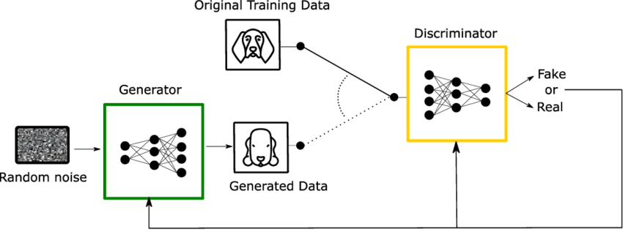
GAN
GANs are a class of artificial intelligence algorithms used in unsupervised machine learning for generating synthetic data. Applications: Image generation, style transfer, and Data Augmentation

Slide 47
GAN
Generative Adversarial Networks (GANs) are a class of deep learning models designed to generate new data that is similar to existing data. GANs consist of two neural networks, a Generator and a Discriminator, that work together in an adversarial setting:
Generator: Generates fake data (images, audio, etc.).
Discriminator: Evaluates if the data is real (from the training set) or fake (from the generator).
The goal of GANs is to train the generator to create data that is indistinguishable from real data, as the discriminator tries to detect the fake data.

Slide 48
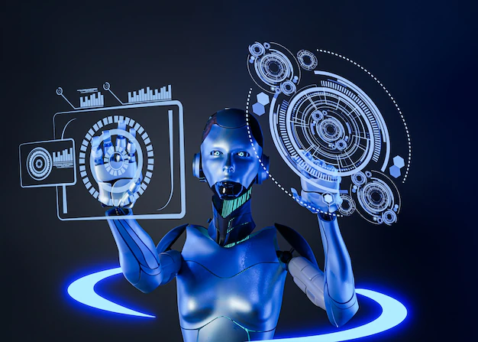
Generative Passive Model
Class of generative models that create new data instances without the need for explicit training.
Techniques: Rule-based systems, procedural generation, and evolutionary algorithms.
Applications: Content generation, Level design, and Creative arts

Slide 49
Data Science Industry Applications, Workflow and Job Roles

Slide 50
Industry Applications

Slide 51

Health Care
University of Oxford researchers created an AI system that scanned routine medical data to predict risk of cardiac events in the next 10 years.
AI Predict Heart Attack
Better Than Doctors
https://www.theguardian.com/society/2023/nov/13/ai-could-predict-heart-attack-risk-up-to-10-years-in-the-future-finds-oxford-study
https://www.ox.ac.uk/news/2023-11-13-ai-tool-could-help-thousands-avoid-fatal-heart-attacks

Slide 52

AI will fight challenging diseases
We'll Soon Trust AI More Than Doctors
From Diagnosis to Treatment

Slide 53
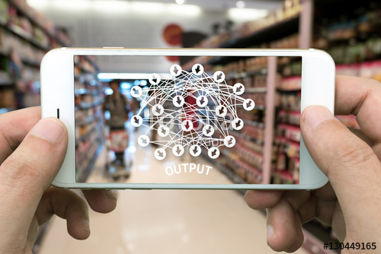
Retail
Machine Learning in Retail
what to stock, how much to buy, what products to suggest to repeat customers. But doing more with that data using machine learning is just what retailers need to really succeed in the current market.
http://www.mckinsey.com/business-functions/mckinsey-analytics/our-insights/the-age-of-analytics-competing-in-a-data-driven-world
https://www.forbes.com/sites/garydrenik/2023/08/22/retail-redefined-ais-affinity-for-personalized-engagement/?sh=6065b4537a3a

Slide 54
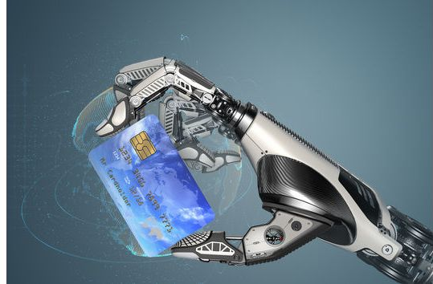
AI in Banking
Fraud Transactions Detection
Predicting risk of asset class based on future context models.
More personalized and faster customer experiences

Slide 55

Financial Services - American Express
American Express processes $1 trillion in transaction and has 110 million AmEx cards in operation.
They rely heavily on data analytics and machine learning algorithms to help detect fraud in near real time, therefore saving millions in losses.
Additionally, AmEx is leveraging its data flows to develop apps that can connect a cardholder with products or services and special offers.
They are also giving merchants online business trend analysis and industry peer benchmarking.

Slide 56

Manufacturing - Volvo
Cars are increasingly connected and generate data that can be used in a number of ways.
Volvo uses data to help predict when parts would fail or when vehicles need servicing, uphold its impressive safety record by monitoring vehicle performance during hazardous situations and to improve driver and passenger convenience.
Volvo is also conducting its own research and development on autonomous vehicles.

Slide 57
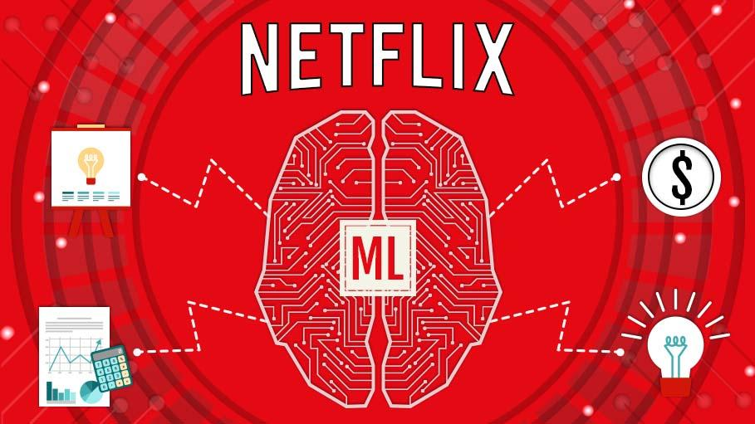
Media - Netflix
Big data analytics is helping Netflix predict what its customers will enjoy watching.
They are also increasingly a content creator, not just a distributor, and use data to drive what content it will invest in creating.
Due to the confidence they have in the data findings, they are willing to buck convention and commission multiple seasons of a new show rather than just a pilot episode.

Slide 58


Retail - Burberry
When you first think of Burberry, you likely consider its luxury fashion and not first consider them a digital business.
However, they have been busy reinventing themselves and use big data and AI to combat counterfeit products and improve sales and customer relationships.
The company’s strategy for increasing sales is to nurture deep, personal connections with its customers.
As part of that, they have reward and loyalty programs that create data to help them personalize the shopping experience for each customer

Slide 59

Service - Microsoft
Central to everything Microsoft does is leveraging smart machines.
Microsoft has Cortana, a virtual assistant; chatbots that run Skype and answer customer service queries or deliver info such as weather or travel updates and the company has rolled out intelligent features within its Office enterprise.
Other companies can use the Microsoft AI Platform to create their own intelligent tools.
In the future, Microsoft wants to see intelligent machines with generalized AI capabilities that allow them to complete any task.

Slide 60

Supply Chain and Logistics - Sam’s Club
Back office automation is achieved with document processing done by digital workers in conversation with RPA.
Supply chain tracking to automate shipping.
Planning is done by AI-powered demand forecasting.
Inventory automation is achieved through robots installed with a computer vision system to scan inventory levels in its stores and warehouses.

Slide 61

Social Media - X (formerly known as Twitter)
From what tweets to recommend to fighting inappropriate or racist content and enhancing the user experience, Twitter has begun to use artificial intelligence behind the scenes to enhance their product.
They process lots of data through deep neural networks to learn over time what users preferences are.

Slide 62
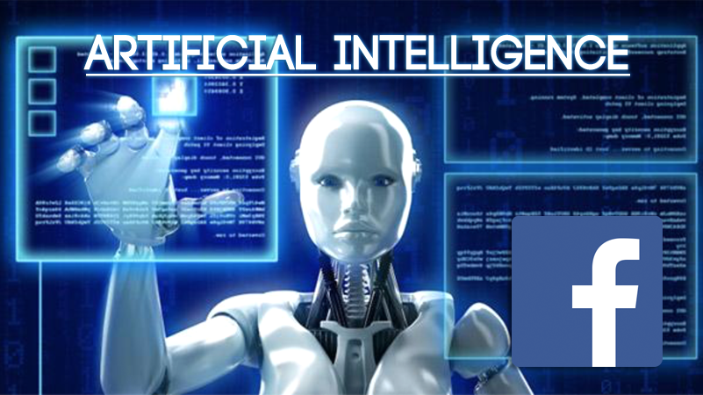
Social Media - Facebook
Deep learning is helping Facebook draw value from a larger portion of its unstructured datasets created by almost 2 billion people updating their statuses 293,000 times per minute.
Most of its deep learning technology is built on the Torch platform that focuses on deep learning technologies and neural networks.

Slide 63

Consumer goods - Barbie
Using natural language processing, machine learning and advanced analytics, Hello Barbie listens and responds to a child.
A microphone on Barbie’s necklace can record and transmit to the servers at ToyTalk.
There, the recording is analyzed to determine the appropriate response from 8,000 lines of dialogue.
Servers transmit the correct response back to Barbie in under a second so she can respond to the child.

Slide 64
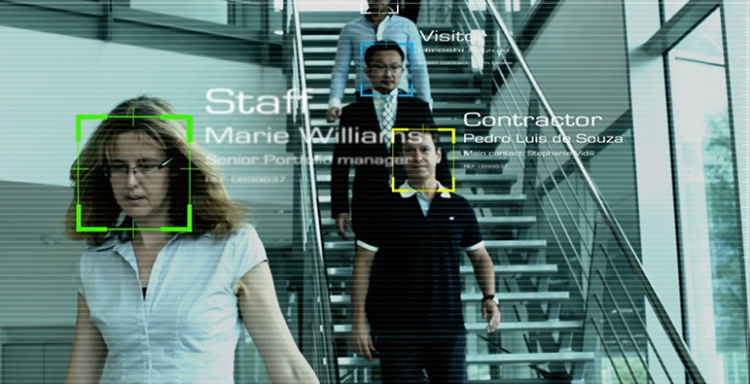

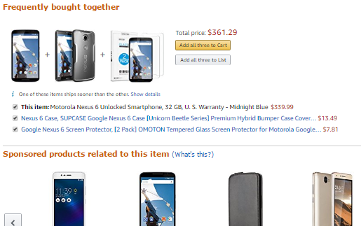

Some more..
HR Analytics
Facial Recognition
Recommendations
Skin Cancer Deduction

Slide 65
Data Science Workflow

Slide 66
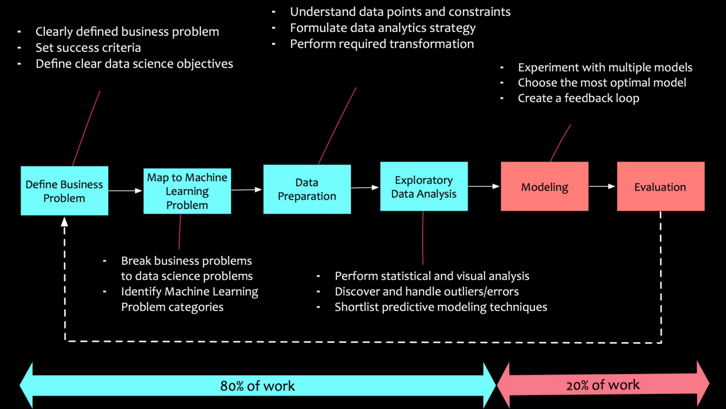
Data Science Workflow

Slide 67
Data Science Workflow
Problem Definition
✔ Clearly define the business problem or question you are trying to solve. ✔ Identify key objectives, stakeholders, and success metrics.
✅ Example:
Predict customer churn for a telecom company.
Detect fraudulent transactions in a banking system.
Data Collection 📊
✔Gather relevant structured and unstructured data from various sources. ✅ Data Sources:
Databases (SQL, NoSQL)
APIs & Web Scraping
IoT Sensors & Logs
CSV, Excel, JSON, Big Data (Hadoop, Spark)
✅ Example:
Collect customer call records and complaints for churn prediction.
📌 Tools: SQL, Python (Pandas, BeautifulSoup, Scrapy), Hadoop, Spark

Slide 68
Data Cleaning & Preparation
✔ Handle missing values, remove duplicates, correct data types, and remove outliers. ✔ Convert raw data into a structured format for analysis.
✅ Common Issues & Fixes:
Missing Data: Fill with mean/median/mode or use ML techniques.
Outliers: Use IQR method or Z-score analysis.
Data Formatting: Convert categorical data to numerical (One-Hot Encoding, Label Encoding).
📌 Tools & Techniques: Pandas, NumPy, Scikit-learn, OpenRefine
Exploratory Data Analysis (EDA) 📊
✔ Understand data patterns, relationships, and trends using statistics & visualization. ✔ Detect correlations between variables.
✅ Example:
Analyze customer behavior patterns for churn prediction.
Check if fraudulent transactions are linked to specific locations.
📌 Techniques: Descriptive Statistics, Box Plots, Heatmaps, Histograms, Pair Plots 📌 Tools: Matplotlib, Seaborn, Pandas Profiling, Plotly, Power BI, Tableau

Slide 69
Feature Engineering ⚙️
✔ Create new meaningful features from raw data to improve model accuracy. ✔ Select the most relevant features and remove irrelevant ones (Dimensionality Reduction).
✅ Techniques:
Feature Scaling (Normalization, Standardization)
Feature Selection (PCA, LASSO, Correlation Analysis)
Feature Creation (Combining variables, Date-Time Features)
📌 Tools: Scikit-learn, Featuretools, PCA
Model Selection & Training 🤖
✔ Choose the right machine learning model based on the problem type:
Regression (Continuous Output): Linear Regression, Decision Trees
Classification (Categorical Output): Logistic Regression, Random Forest, SVM
Clustering (Unsupervised Learning): K-Means, Hierarchical Clustering ✔ Train models on training data and evaluate their performance.
📌 Tools: Scikit-learn, TensorFlow, PyTorch, XGBoost
Further is Model Deployment

Slide 70
Data Science Roles

Slide 71
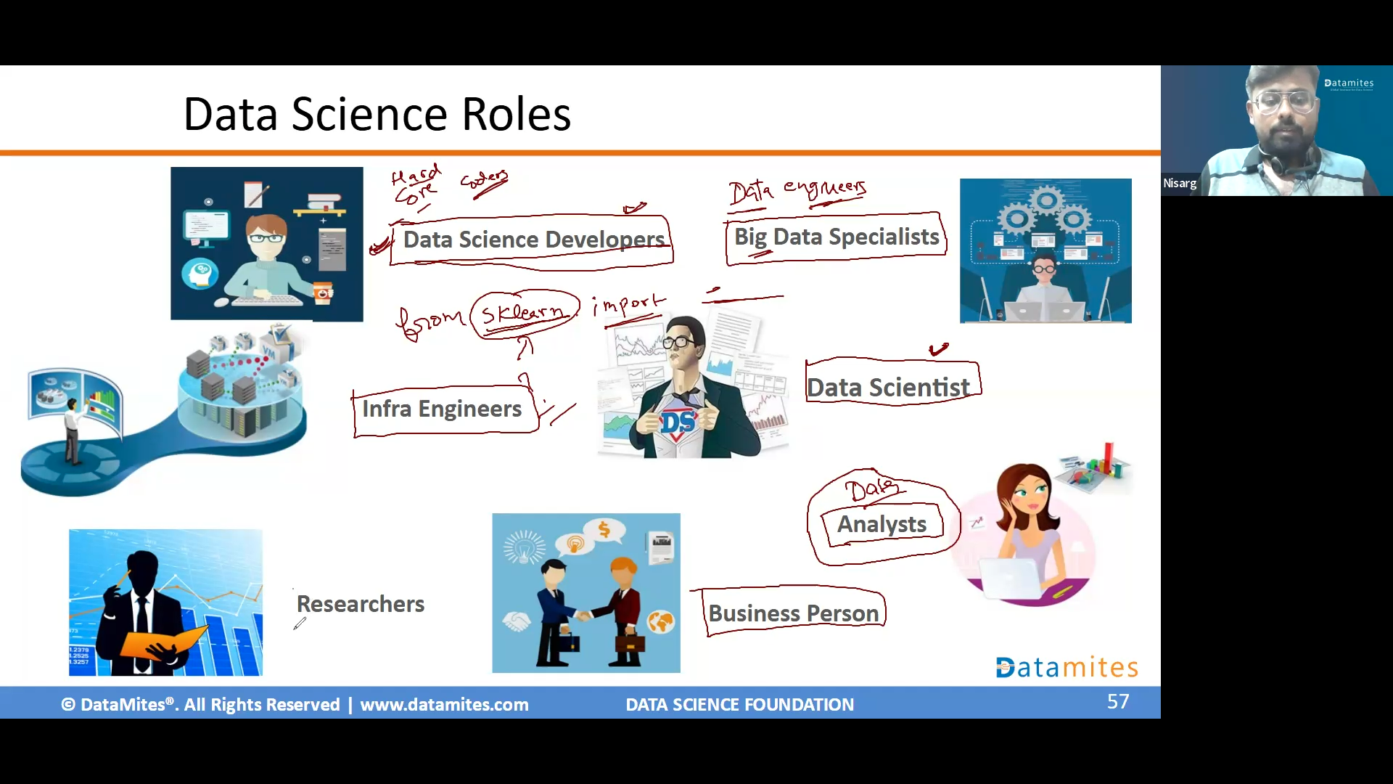

Slide 72

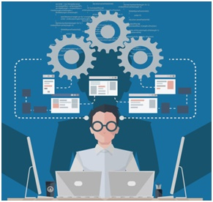

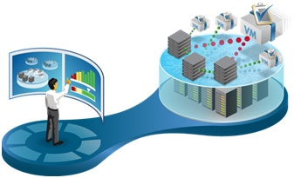



Data Science Roles
Data Science Developers
Big Data Specialists
Data Scientist
Infra Engineers
Analysts
Researchers
Business Person

Slide 73
DS Infrastructure Engineers
Data Science Engineers are hard-core techies who deal with Data Science Infrastructure, ie., hardware, software applications and other aspects to get the back end of Data Science up and running.
They set up the entire IT infrastructure from servers, networks to processes, also manage it such as infrastructure monitoring, application management, database administration etc.,

Slide 74
Data Science Developers
Data Science Developers are the ones, who code the models and applications through programing in R Language, Python etc., They are versatile developers, who have good knowledge on math & statistics, machine learning algorithms and related concepts.
As this domain of data science development is evolving rapidly, these developers are expected to keep themselves updates with all latest technological advances from development perspective, so that they can use the right platform to achieve their goal in effective manner.

Slide 75
Machine Learning Specialist
These are the professional with deep knowledge in computer science and mathematics.
They engage in machine learning and deep learning heavily.
They create predictive and prescriptive models based on the machine learning algorithms, such as random forest, Artificial Neural Network, K-NN etc.,
They are masters in all kinds of data mining techniques pruning, regularization etc., helping to create a robust data science models, which can be used in creating great business insights.

Slide 76
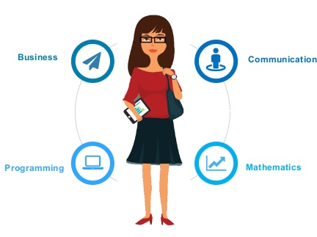
Big Data Specialists
Big Data Specialists focus on designing model for of Big Data Processing as one of the building block of Data Science workflow
Their work involve architecture of Data gathering including streaming and snapshots, storing and processing in effective and efficiently manner using Big Data Technologies

Slide 77
Researchers
Researchers are domain experts. These professionals have more expertise in Data analysis, Data Science related Statistics along with significant expertise in specific domain such as HR, Marketing, Fraud Analytics, Health Care, Finance etc.,
They have less emphasis and knowledge in backend part such as IT infrastructure, coding, computer science etc.,

Slide 78
Data Science Analyst
These professionals are focussed on day-to-day analysis of data, including website analytics, retrieving data from various data sources and creating data visualizations.
They work closely with business person. Their role is to provide the reports from data analysis with appropriate visualizations in an easy to understand format.There by enabling the decision makers to gain valuable business insights

Slide 79

Business Person
This role is the one, who manages the entire Data Science project. We can call him as sponsor. This roles is predominantly business focussed and, formulates the problem statements for which, Data science project needs to find the answers. This role also helps in understanding, interpreting the intermediate results of the data science projects and drive the project to final solution.
Though this role is primarily business focussed, he/she must also speak Data in order to able to perform the job well.

Slide 80
Data Scientist
These are the professional who is able to perform every aspect of Data Science, sometime called as full-stack Data science professionals. Well, these people are rare as mastering entire Data Science roles is difficult, if not impossible.
If a company manages to hire full-stack Data Scientist, there would be tremendous progress in transforming the business in gain significant competitive advantage by finding solutions to important business questions.

Slide 81
Lead analytics transformation across organization
Lead analytics transformation
across organization
Deliver data- and analytics-driven insights and interface with end users
Business
Leaders
Delivery
Managers
Business
Lead analytics transformation
across organization
Ensure quality and consistency of present and future data flows
Data Analysts
Data Architects
Lead analytics transformation across organization
Process Consultants
Analytics
Technology
Data Scientists
Build interactive decision-support tools and implement solutions
Data Engineers
Visual Analysts
Collect, structure, and analyse data
Visualize data and build reports and dashboards
Develop statistical models and algorithms

Slide 82
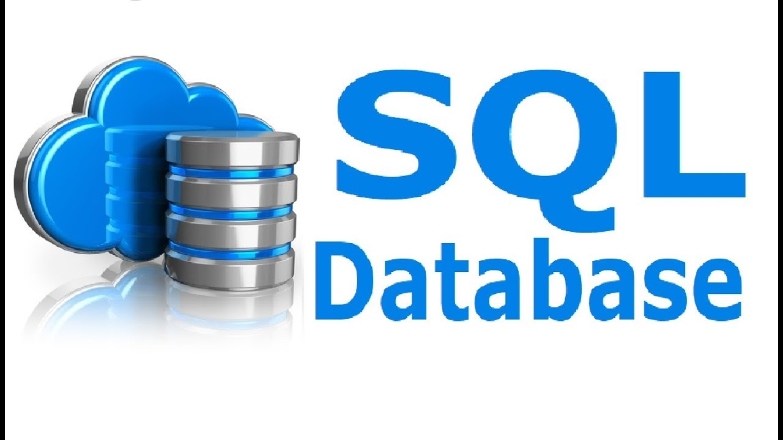
Why SQL for Data Scientist?
Data scientists can leverage SQL to extract, analyze, and derive meaningful insights from the relational database, informing business decisions and strategies.
SQL is a powerful tool for efficiently handling and transforming data for analysis in real-world scenarios.

Slide 83
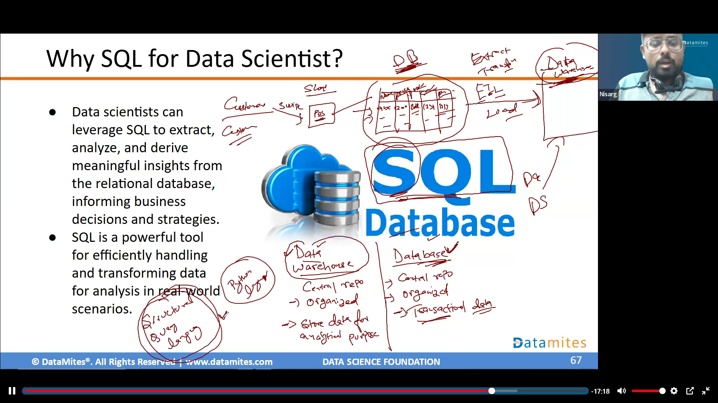

Slide 84

Why BI tools for Data Scientist?
BI tools provide a user-friendly interface for data exploration, visualization, and reporting.
Enhance the efficiency and effectiveness of data scientists in their analytical workflows.

Slide 85
Installations

